Slide 1
Agile Estimation & Metrics
Aruna Kumbhar

Slide 2
Revise
Classification of Agile Methods
Agile Teams
Agile Team Meetings
Agile Methodologies – Scrum, XP, FDD, Crystal, Kanban, Adaptive Software Development (ASD), Lean
Traditional Agile Estimation Techniques
Agile Reports

Slide 3
Advanced Agile Forecasting Techniques
Why do we need advanced forecasting?
Suppose your team estimated:
Sprint 1 → 20 stories completed
Sprint 2 → 18 stories
Sprint 3 → 24 stories
Sprint 4 → 16 stories
Will Sprint 5 complete exactly 20 stories?
Probably not!
Real life always changes.
Bugs appear
Team members take leave
Requirements change
Production issues happen
Advanced forecasting accepts this uncertainty instead of ignoring it.

Slide 4
1. Monte Carlo Simulation
Imagine rolling a dice. Will you always get 6? No
Now imagine rolling it 10,000 times.
After many rolls, you can predict:
Chance of getting 6
Average score
Most likely result
Monte Carlo Simulation works exactly like this
Result | Probability
Finish in 4 sprints | 10%
Finish in 5 sprints | 65%
Finish in 6 sprints | 22%
Finish in 7 sprints | 3%
Total backlog = 100 stories
The simulation runs thousands of virtual futures
Think about weather forecasting
Meteorologists don't say: "Tomorrow it WILL rain."
Instead they say: "There is an 80% chance of rain."

Slide 5
2. Probabilistic Planning
Imagine your professor says: "Assignment submission is on Monday." Would you start Sunday night? Probably not.
You would finish earlier to increase the probability of submitting on time.
Probabilistic planning follows the same idea
Instead of promising a single fixed date, teams state outcomes as percentages, such as a "50% chance in 3 sprints, 85% chance in 4 sprints"

Slide 6
3. Throughput-Based Forecasting
Throughput means: How many work items does the team finish in a given time?
Sprint | Stories Finished
1 | 10
2 | 11
3 | 12
4 | 9
5 | 13
Average throughput = 11 stories per sprint
Remaining stories = 55
Prediction 55 ÷ 11 = 5 sprints

Slide 8
Agile Metrics and Agile Approach to Quality Assurance
Imagine you are playing a cricket match 🏏
After every match, what you do?
How many runs did we score?
How many wickets did we lose?
How many catches were dropped?
Who performed consistently?
These measurements help improve the team
Similarly, in Agile, we use Agile Metrics to measure the team's performance and Quality Assurance (QA) to ensure we deliver a high-quality product.

Slide 9
Agile Metrics
Agile Metrics are measurements that help Agile teams understand their progress, productivity, quality, and predictability
Imagine driving a car without looking at the speedometer or fuel gauge.
Would you know:
How fast you're going?
How much fuel is left?
Whether you'll reach your destination?
Probably not.
Similarly, Agile Metrics help teams answer:
Are we making progress?
Are we improving?
Are we delivering quality?
Will we finish on time?

Slide 10
1. Velocity
Velocity tells us: How much work a team completes in one Sprint
Sprint | Story Points Completed
Sprint 1 | 20
Sprint 2 | 24
Sprint 3 | 22
Average Velocity
= (20 + 24 + 22) ÷ 3
= 22 Story Points
This helps estimate future work.

Slide 11
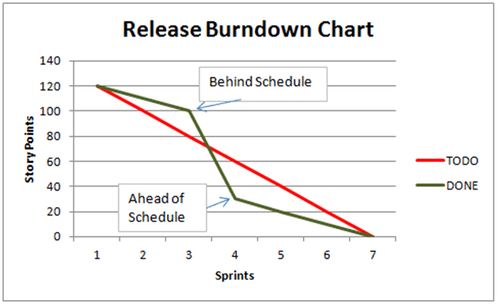
2. Burndown Chart
A Burndown Chart shows: How much work remains in the Sprint
As work gets completed, Remaining work decreases.
Goal: Reach Zero Remaining Work on the last Sprint day.

Slide 12
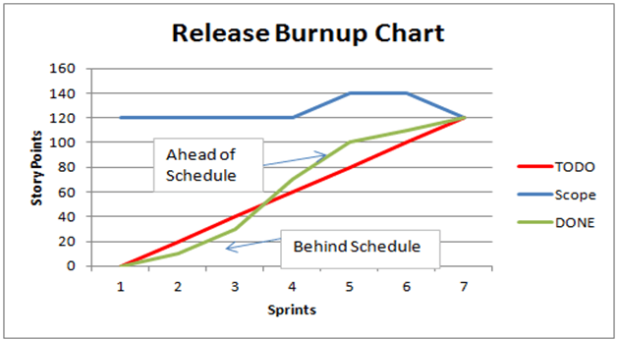
3. Burnup Chart
Burnup shows
Work Completed
Total Scope
Very useful when project scope changes frequently

Slide 13
4. Cycle Time
Time taken from Starting a task to Completing it
Task started on Monday Finished on Thursday
Cycle Time = 4 days
5. Lead Time
Tracks the complete journey from the initial idea or request to final production deployment
Customer requests a feature on 1st July
Development starts on 5th July
Feature Completed on 15 July
Lead Time =15 days

Slide 14
6. Defect Density
Measures Number of bugs per feature/module. Lower defect density means Better quality.
Module A has 2 bugs
Module B has 20 bugs
Clearly, Module A has better quality
7. Escaped Defects
These are bugs found after the product is released
Testing team missed Login Bug and Customer reported it.
That is an Escaped Defect

Slide 15
8. Team Happiness
Agile also measures People!
Because Happy teams build better software.
Common ways:
Surveys
Sprint Retrospectives
Anonymous feedback

Slide 17
Engineering & Design
Agile Practices
Agile Practice | Meaning
Small Iterations | Build small pieces every 2–4 weeks
Daily Scrum | 15-minute daily meeting
Pair Programming | Two developers work together
Continuous Testing | Testing throughout development
Continuous Integration | Merge code frequently
Customer Feedback | Show working software regularly
Refactoring | Improve code without changing functionality
Retrospective | Learn from every sprint

Slide 18
Variance in Agile
Variance means - Difference between what was planned and what actually happened
Example
Planned:
Finish 10 User Stories
Actual:
Finished 8 User Stories
Variance = 2 stories
Estimated Time = 40 hours
Actual Time = 55 hours
Variance???
Agile teams continuously measure variance so future planning becomes more accurate
Causes of Variance
Requirement changes
Technical issues
Team member leave
Wrong estimation
Unexpected bugs

Slide 19
Managing Unstable Requirements
One of Agile's biggest strengths is handling changing requirements
Traditional Software
Customer changes requirement, Developer says "Too late."
Agile
Customer changes requirement, Team says "We'll include it in the next sprint."
Agile Techniques for Managing Changes
Product Backlog
Sprint Planning
Customer feedback
Frequent releases
Prioritization
Small iterations

Slide 20
Requirements Elicitation
Requirements Elicitation means Collecting requirements from stakeholders
Simply, "Understanding what the customer really wants."
Common Techniques:
1. Interview
2. Brainstorming
3. Observation
4. Questionnaire
5. Workshops
6. Prototype

Slide 21
Agile Requirements Prioritization
Not all requirements are equally important.
Some are
Must Have
Some are
Nice to Have
Agile decides what should be built first.
Priority | Meaning
Must Have | Essential
Should Have | Important
Could Have | Optional
Won't Have | Not now

Slide 22
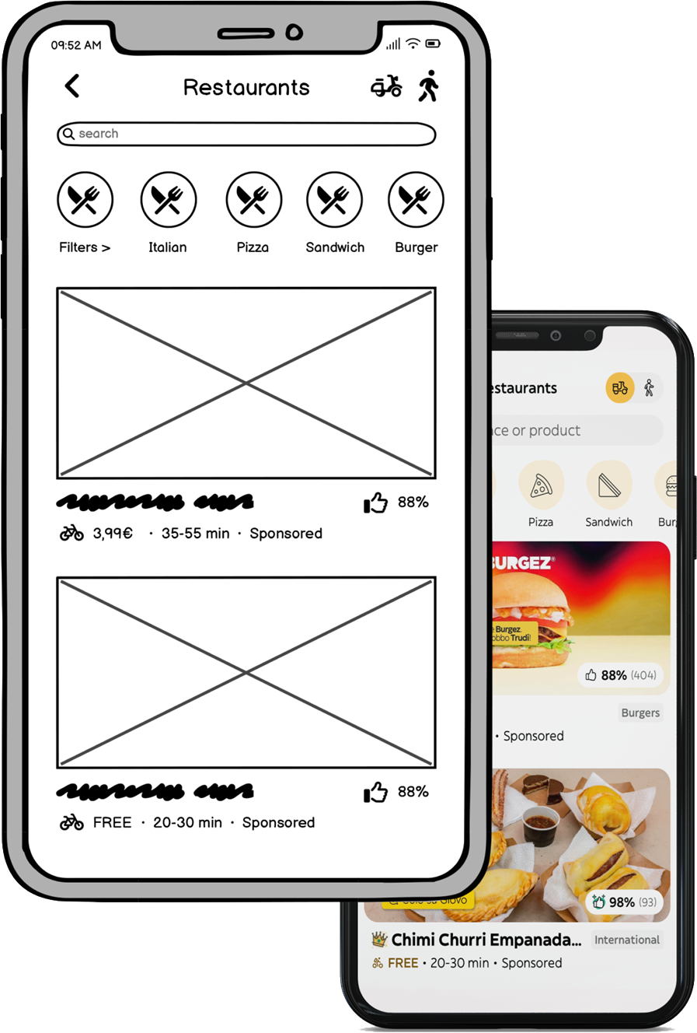
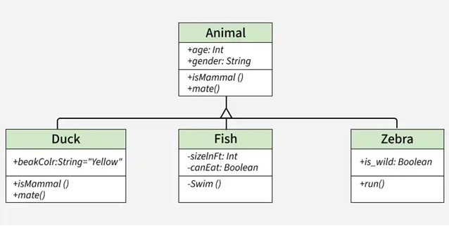
Agile Requirements Modeling
Requirement Modeling means Representing requirements visually
User Stories
Flowcharts
Wireframes
Mock-ups
UML Diagrams

Slide 23
Agile Requirements Generation
Requirement Generation means Creating requirements continuously
Requirements keep evolving
Customer Feedback New User Stories Sprint Review More Feedback New Stories
Cycle continues.

Slide 24
Quality Assurance (QA) in Agile
In Traditional Models, Development happens first, Testing happens later. Problem: If bugs are found late, Fixing becomes expensive
In Agile Model, Testing happens throughout development. Quality is built into every Sprint
Not only testers, but
Developers
Testers
Scrum Master
Product Owner
Everyone contributes
Quality is everyone's responsibility

Slide 25
Agile Quality Practices
1. Continuous Testing
Write Login Page
↓
Immediately test Login
↓
Fix bugs
↓
Move to next feature
Testing begins immediately. Instead of waiting till the end, Every feature is tested during development.
2. Test Automation
Instead of manually testing 100 times, A testing tool performs repetitive tests automatically
Instead of checking attendance manually, A biometric machine does it automatically.

Slide 26
3. Test-Driven Development (TDD)
Write Test -> Write Code -> Run Test -> Improve Code
4. Pair Programming
Two developers work together. One writes code. One reviews simultaneously.
This reduces mistakes.
5. Continuous Integration (CI)
Developers merge code several times a day. Every merge automatically
Builds application
Runs tests
Detects bugs
before release

Slide 27
6. Acceptance Testing
Customer verifies whether the feature meets expectations.
Customer requested Online Payment.
QA confirms Payment works.
Customer also confirms Payment matches business needs

Slide 28
Agile QA Principles

Slide 29
Software Testing
Imagine you have bought a new smartphone 📱
Before using it, you naturally check several things:
Does it make calls? ☎️
Is the screen easy to use? 👆
Does it become slow when many apps are open? 🐢
Is your fingerprint data secure? 🔒
Similarly, software applications also undergo different kinds of testing before they are released.

Slide 30
What is Software Testing?
Software Testing is the process of checking whether a software application works correctly, meets user requirements, and is free from defects
Its goal is to ensure that the software is:
Correct ✅
Fast ⚡
Secure 🔒
User-friendly 😊

Slide 31
1. Functionality Testing
It verifies that every feature works according to the requirements
Imagine buying a washing machine.
You check:
Does it wash clothes?
Does the spin mode work?
Does the timer function correctly?
Consider an Online Shopping Website.
Things to test:
✅ Login works
✅ Search products
✅ Add to Cart
✅ Remove from Cart
✅ Place Order
✅ Payment succeeds
You are testing its functionality.
If all these features work correctly, the functionality is correct.

Slide 32
2. UI Testing (User Interface Testing)
It checks the appearance and interaction of the application
Suppose two restaurants serve the same food.
Things to check:
Buttons visible
Fonts readable
Logo is displayed
Images load correctly
Colors are consistent
Navigation works
Mobile layout looks good
Restaurant A
Clean tables
Nice lighting
Comfortable chairs
Restaurant B
Dirty tables
Broken chairs
Poor lighting
Which one would you prefer?
The food may be the same, but the user experience is completely different

Slide 33
3. Performance Testing
It measures speed, stability, and responsiveness
Imagine booking train tickets during a festival. Thousands of users log in at the same time.
Does the website remain fast?
Does it crash?
How quickly does it load?
This is Performance Testing.

Slide 34
Types of Performance Testing
A. Load Testing
B. Stress Testing
Tests software under expected user load. Can the website handle 5,000 users?
Pushes the system beyond its limit.
Can it survive 100,000 users?
C. Endurance Testing
D. Spike Testing
Checks whether the software performs well over a long period. Can the server run continuously for 48 hours?
Suddenly increases the number of users. Users increase from 500 to 20,000 within one minute.

Slide 35
4. Security Testing
It ensures that user data remains safe.
Think about your house.
You have:
Strong locks
CCTV cameras
Security guards
Alarm system
These protect your house.
For an Online Banking App:
Security Testing checks:
Strong passwords
Secure login
Data encryption
Unauthorized access prevention
Safe money transfer
Similarly, software needs protection.

